Slide 1
Programmable Elbow Orthosis Team 10: David Cuevas – Nathan Glaser – Joe Loredo – Rafael Salas
Project Goals
Our goal is to create a programmable elbow orthosis to
Provide structural support for the elbow
Resist and restrict harmful ranges of motion
Assist with intended elbow movements
Legend
Rafael Salas
David Cuevas
System Block Diagram
Joe Loredo
Body-to-Sensor Interface
Signal Filtering
Signal Characterization
Communication
Nathan Glaser
SPI
Power
11.1VDC LiPo Battery
Battery Life
Battery Protection
Data Processing
Communication
Sensor Logic
Motor Logic
UART
BLUETOOTH
User Interface
Android App
Calibration
Limit Setting
PWM
Motor-to-Body Interface
Motor & Structure
Control & Feedback
PCB Integration

Slide 2
Subsystem – Team Matrix
Subsystem | Primary Contact | Responsibilities
Body-to-Sensor Interface | Nathan Glaser | Develop and test wearable sensors which will transmit elbow angle and muscle activity Filter noise from raw sensor signal Ensure setup is not invasive and is not restrictive
Data Processing | Rafael Salas | Convert sensor data into controller variables Manipulate data to satisfy user specifications Reconvert result into motor signal
Motor-to-Body Interface | David Cuevas | Actuate motor and articulate elbow based on microcontroller signal Ensure movement is assistive and natural
Power | Joe Loredo | Provide portable and sustained power to each subsystem
User Interface | Joe Loredo | Connect user-friendly interface which will calibrate EMG sensors and specify custom angle limits (without customizing microcontroller source code for every user)

Slide 3
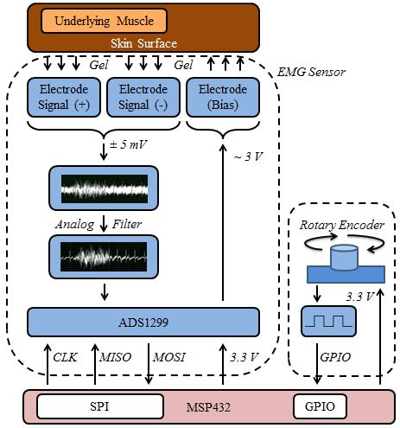
Subsystem 1:
Body-to-Sensor Interface
Nathan Glaser
OBJECTIVES:
Quantify Intention and Current State
Communicate with Main Controller
Filter Signal
Compact Packaging
COMPLETE:
Characterize EMG Signal
Independent* Muscles
Linear (R² > 0.95)
Rotary Encoder
SPI Communication
Signal Processing
FIR High Pass FIlter
Filter Coefficients (Matlab)
Convolution (C Code)
Moving Average Function
ADS1299 PCB Schematic
INCOMPLETE:
Implement Code on MSP432
Muscle Group Comparator
Linear Calibration Routine
Real-Time FIR Filter (Trailing Window)
Solder and Test ADS1299 PCB
Integrate Peripheral Sensors
Force Sensitive Resistor

Slide 4
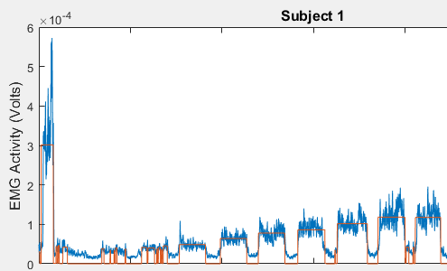
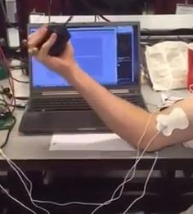
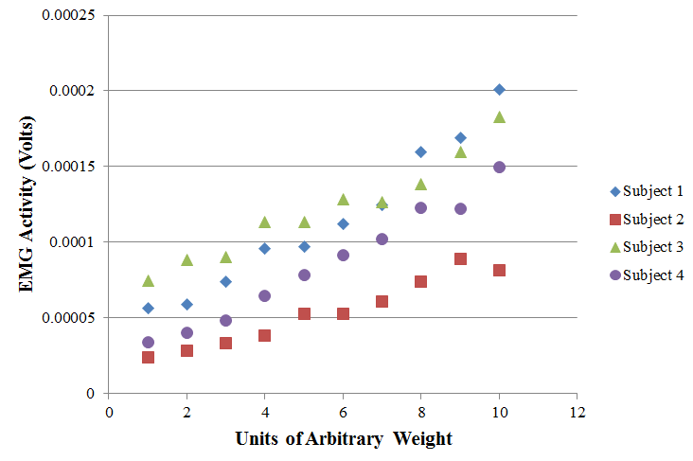
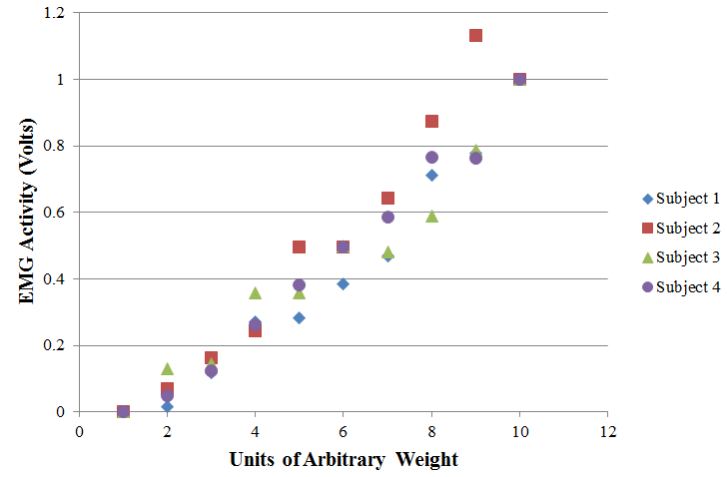
Subsystem 1:
Body-to-Sensor Interface
Linearity Test
Units of Weight
7
8
5
6
3
4
2 Calibration Signals
x_{min} = Resting EMG Signal
x_{max} = Max EMG Signal
1
2
x 4 Subjects
y = ( x - x_{min} ) / ( x_{max} - x_{min} )
Calibration Routine
R² > 0.95
R² = 0.94
Non-Zero Y-Intercept Significant:
→ Account for Resting EMG Signal

Slide 5
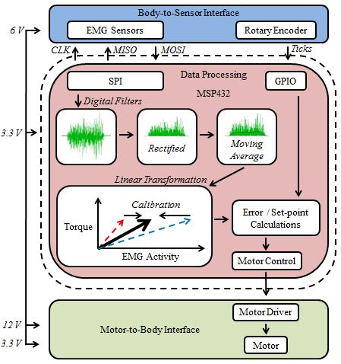
Subsystem 2:
Data Processing
Rafael Salas
Objectives
Filtering Input Sensor Data:
Perform running averages from filtered sensor data.
Produce Motor Variables from Data:
Use filtered data to produce variables to actuate motor.

Slide 6
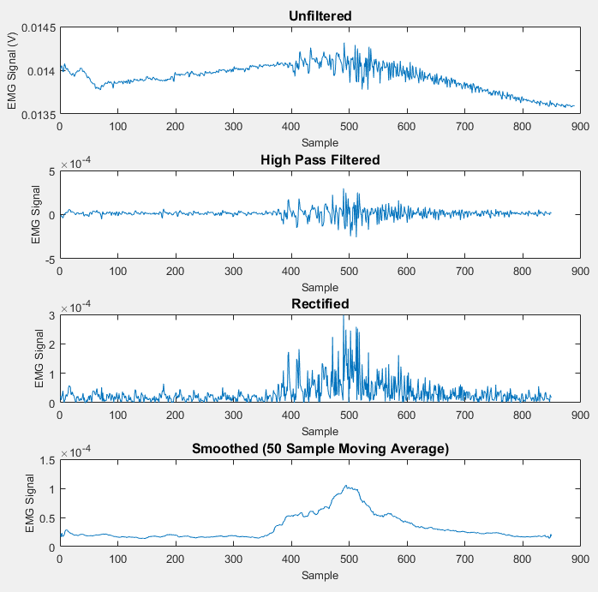
Subsystem 2:
Data Processing
Hardware Filter
High Pass Filter
Signal Window
Trailing Window Size = TBD
(Tested over entire window)
Convolution
Filter Coefficients
FIR Low Pass Filter
Order = 30
f_{Sampling} = 1000 Hz
f_{Stop} = 10 Hz
f_{Pass} = 30 Hz
Motor Logic

Slide 7
Data Processing Flow Chart Rafael Salas
Main Processing Thread
Signal Interrupts
Calibration Interrupt
EMG signal
Rotary signal
Read EMG Signal
Read Rotary Encoder
Calibration Process
Filter Computation
Generate motor control variables
Save generated constants
Set motor driver PWM signals

Slide 8
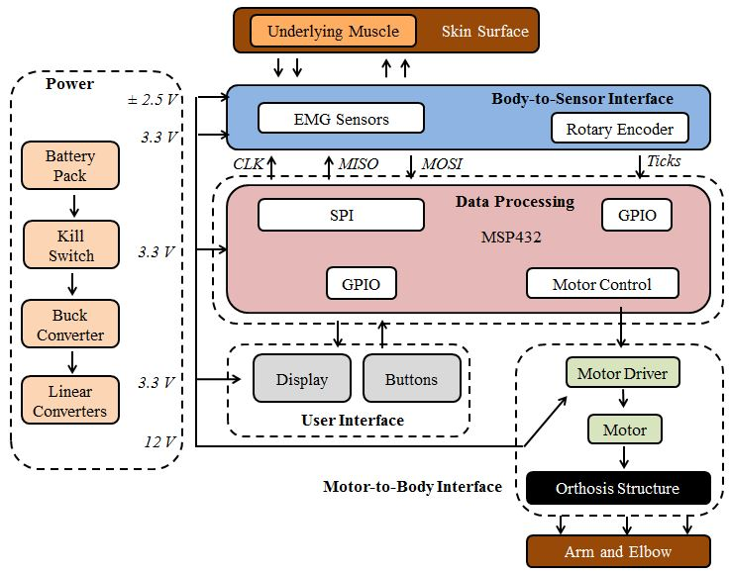
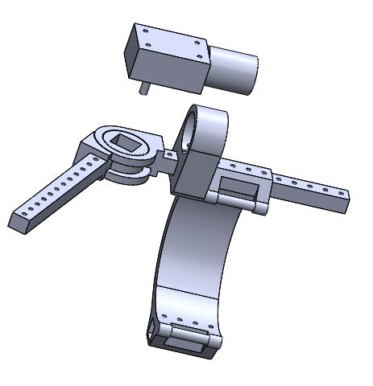
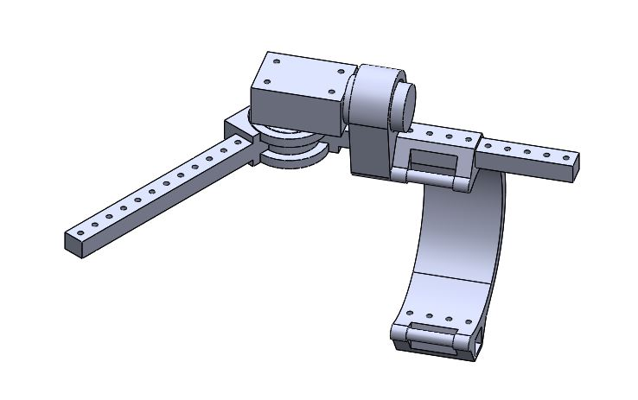
Subsystem 3:
Motor-to-Body Interface
David Cuevas
DC motors were the winners based on their High Torque and low Current draw when compared to Stepper Motors
The Structure will be driven directly by the 9RPM DC motors. This will ensure proper torque distribution and decrease loss of torque by 3d printed gears
Motor
Elbow Orthosis Structure
Structure

Slide 9
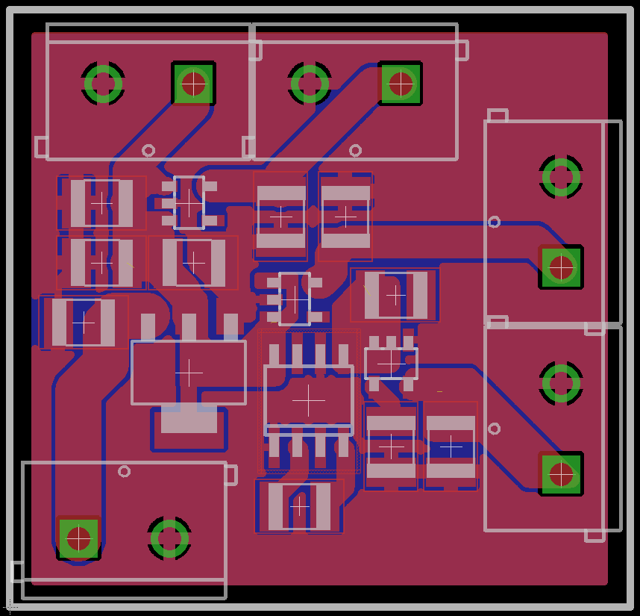
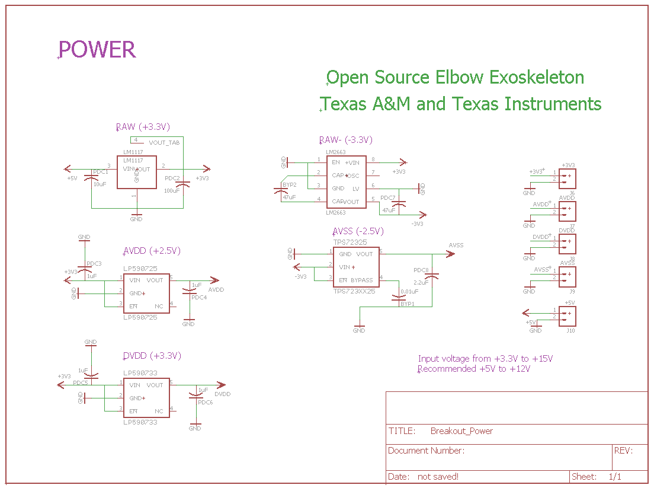
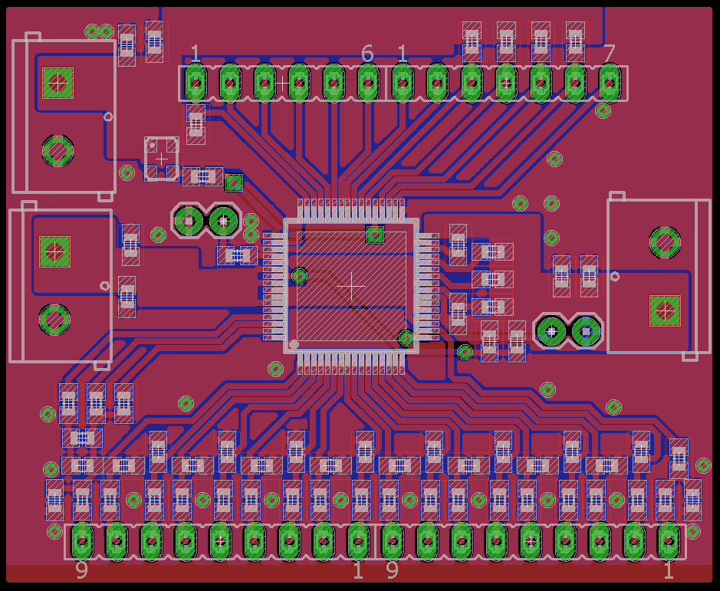
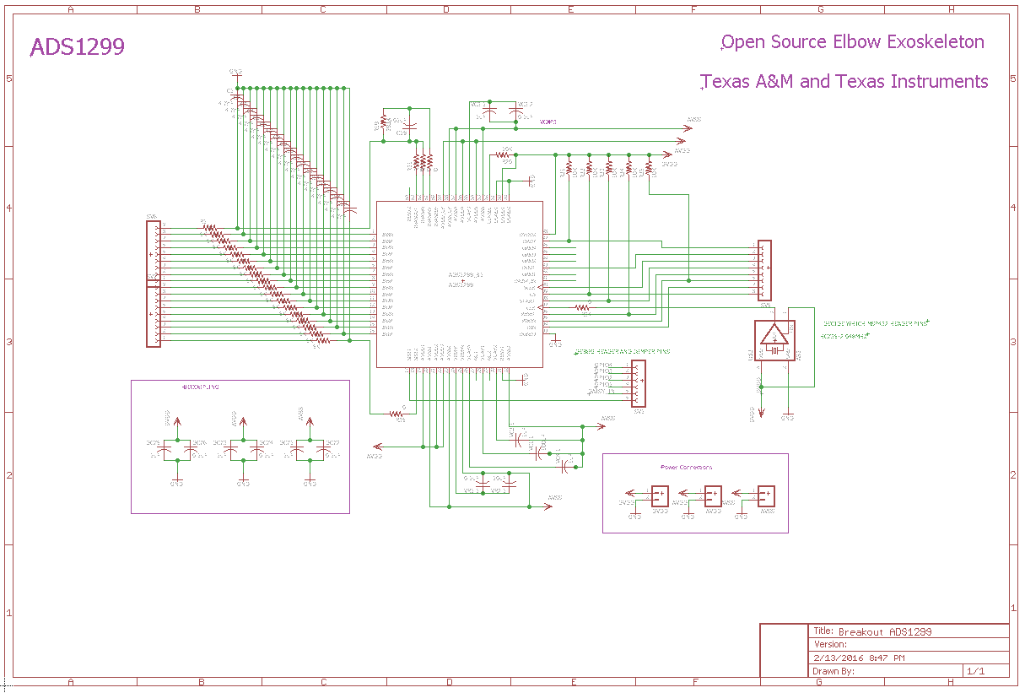
Motor-to-Body PCBs David Cuevas
Power Breakout Board
ADS1299 Breakout Board
Notes:
9

Slide 10
Subsystem 4:
Power
Joe Loredo
LiPo Battery
(11.1) V
ADS1299 Power Circuit
Battery Discharge Alarm + Relay
MSP432
(3.3 V)
Objectives
Provide adequate power for all subsystems
5 linear voltage regulators used to achieve the voltages for the ADS1299 (3.3 and ±2.5 V) and MSP432 (3.3 V)
A buck converter produces the 5 V required by the circuit from a power source of 11.1 V
Discharge alarm in conjunction with a relay switch disconnects the battery if the battery level of any lipo cell gets too low
Switch
ADS1299
(3.3 V, ± 2.5 V)
Motor
Driver
Fuse (2 A)
Buck Converter
(11.1 V➤5 V)
Power BreadBoard Test
Specification | Input (V) | Ideal Output (V) | Actual Output (V) | Current Output (mA)
DROK Buck Converter | 11.1 | 5 | 5.01 | 31
LM1117IMP-3.3/NOPB | 5 | 3.3 | 3.26 | 31
LP5907MFX-2.5/NOPB | 3.3 | 2.5 | 2.48 | 31
LP5907MFX-3.3/NOPB | 3.3 | 3.3 | 3.27 | 31
LM2663M/NOPB | 3.3 | -3.3 | -3.27 | 31
TPS72325DBVT | -3.3 | -2.5 | -2.51 | 31

Slide 11
Subsystem 5:
User Interface
Joe Loredo
Push Limit Option
Back out and select Calibrate
Objectives
Allow the user to set limits and calibrate the orthosis
Communicate with MSP432 using Bluetooth module and Android app
Android app is used to calibrate and set orthosis limits
Utilizes the Motor-Body radial encoder for limits and the Body-Sensor electrodes for calibration
Upper limit option then hit set
Flex muscle and press Set
Lower limit option then hit set
Set calibration

Slide 12
Ongoing Progress/Problems
Body-to-Sensor Interface:
Real-Time FIR Filtering (Trailing Window?)
Multiple Sensor Integration
Juggling (Filter, UART, SPI, PWM, and ADC)
Data Processing:
Managing interrupt flags
Rotary Encoder calibration
Calibration work flow
Motor-to-Body Interface:
Rotary encoder feedback loop
Motor Control Precision
Power & User Interface:
Finish bluetooth connectivity with MSP432
Work with Data Processing to accomplish calibration and limit setting
Solder power board and test all components for appropriate voltage/current output
Construct and test discharge relay circuit

Slide 13
Conclusion
Our team has made substantial progress towards our initial objective.
Each subsystem works in isolation…now we need to integrate them.
Power
Data Processing
Our powered, portable, programmable elbow orthosis:
Provides structural support for the elbow
Resists and restricts harmful ranges of motion
Assists with intended elbow movement
Motor-to-Body
Body-to-Sensor

